Slide 1
Car accident severity
IBM Applied Data Science Capstone Project
Jan Luca Neduchal

Slide 2
Table of contents
Introduction/Business Problem
Data
Methodology
Results
Discussion
Conclusion

Slide 3
Introduction/Business Problem
data given by Coursera
effort to reduce the frequency of car collisions
predict severity of car accidents given the current weather, road and visibility conditions
alert drivers when the current conditions are bad
analysing the impact weather conditions have on car accidents

Slide 4
Data
Data requirements
large amounts of data
numerical data
data needs to be trained and tested for our results to be as accurate as possible

Slide 5
Data
Data description
Data-Collisions.csv
target variable == SEVERITYCODE
SEVERITYCODE is used to measure the severity of a car accident from 0 to 4 within the dataset
to weigh the severity of car accidents we also use WEATHER, ROADCOND and LIGHTCOND
before we can analyse the data, we need to balance it

Slide 6
Methodology
after analysing and cleaning our data we can use it for our machine learning models
KNN: predicting the severity code of an outcome by finding the most similar data point within k distance
Decision Tree: displaying all possible outcomes to analyse the consequences of a decision
Logistic Regression: predicting one of our two severity codes (1 or 2)
after that we test the accuracy of our models

Slide 7
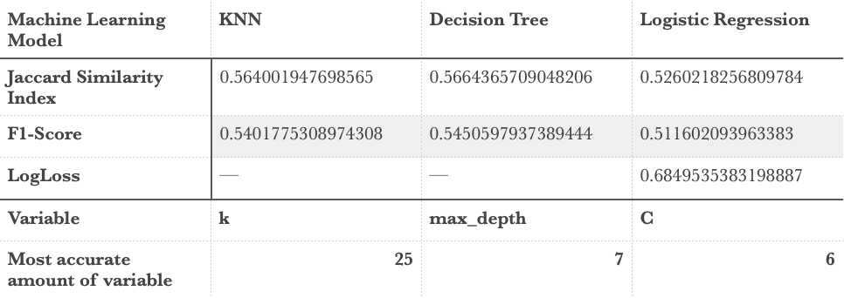
Results

Slide 8
Discussion
beginning: change of data type from ‚object‘ to ‚int8‘ for our algorithms
after that: sample down majority class until values of both classes (1 and 2) match
then: analyze and clean data to prepare it for the ML models
followed by: testing accuracy of our models using the Jaccard Similarity Index, F1-Score and LogLoss

Slide 9
Conclusion
based on historical data
relation between weather conditions and frequency of car accidents
impact on whether or not driving could result in a car accident leading to property damages (class 1) and/or injuries (class 2)

